Slide 1

ENVIRONMENT SETUP

Slide 2
CONTENT
INTRODUCTION
01
MERN STACK ARCHITECTURE
02
MERN STACK COMPONENTS
03
VS CODE INSTALLATION
04
IMPLEMENTATION OF NODE JS AND EXPRESS
CONFIGURATION OF MONGO DB AND MONGOOSE
SETUP OF REACT JS
05
06
07

Slide 3
INTRODUCTION
The phrase MERN stack refers to the following technologies:
MONGODB - A cross-platform document-oriented database program.
EXPRESS. JS - A web application framework for Node.js
REACT - A JavaScript library for building user interfaces.
NODE JS - An open-source, cross-platform JavaScript run-time environment that executes JavaScript code outside of a browser.

Slide 4
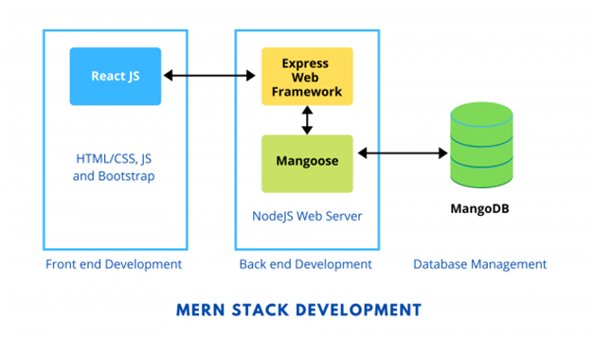
MERN STACK ARCHITECTURE

Slide 5
MERN STACK COMPONENTS
MongoDB: Cross-platform Document-Oriented Database
MongoDB is a NoSQL database where each record is a document comprising of key-value
pairs that are similar to JSON (JavaScript Object Notation) objects. MongoDB is flexible and allows its users to create schema, databases, tables, etc. Documents that are identifiable by a primary key make up the basic unit of MongoDB. Once MongoDB is installed, users can make use of Mongo shell as well. Mongo shell provides a JavaScript interface through which the users can interact and carry out operations (eg: querying, updating records, deleting records).
Why use MongoDB?
Fast – Being a document-oriented database, easy to index documents. Therefore a faster response.
Scalability – Large data can be handled by dividing it into several machines.
Use of JavaScript – MongoDB uses JavaScript which is the biggest advantage.
Schema Less – Any type of data in a separate document.

Slide 6
MERN STACK COMPONENTS
Data stored in the form of JSON –
1. Objects, Object Members, Arrays, Values, and
Strings
2. JSON syntax is very easy to use.
3. JSON has a wide range of browser compatibility.
4. Sharing Data: Data of any size and type(video, audio)
can be shared easily.
Express: Back-End Framework:
Express is a Node.js framework. Rather than writing the code using Node.js and creating loads of Node modules, Express makes it simpler and easier to write the back-end code. Express helps in designing great web applications and APIs. Express supports many middlewares which makes the code shorter and easier to write.

Slide 7
MERN STACK COMPONENTS
Asynchronous and Single-threaded.
Efficient, fast and scalable
Has the biggest community for Node.js
Express promotes code reusability with its built-in router.
Robust API
Create a new folder to start your express project and type below command in the command prompt to initialize a package.json file. Accept the default settings and continue.
React: Front-End Library
React is a JavaScript library that is used for building user interfaces. React is used for the
development of single-page applications and mobile applications because of its ability to handle rapidly changing data. React allows users to code in JavaScript and create UI components.

Slide 8
MERN STACK COMPONENTS
VIRTUAL DOM - A virtual DOM object is a representation of a DOM object. Virtual DOM is
actually a copy of the original DOM. Any modification in the web application causes the entire UI to re-render the virtual DOM. Then the difference between the original DOM and this virtual DOM is compared and the changes are made accordingly to the original DOM.
JSX - Stands for JavaScript XML. It is an HTML/XML JavaScript Extension which is used in
React. Makes it easier and simpler to write React components.
COMPONENTS - ReactJS supports Components. Components are the building blocks of UI wherein each component has a logic and contributes to the overall UI. These components also promote code reusability and make the overall web application easier to understand.
HIGH PERFORMANCE - Features like Virtual DOM, JSX and Components makes it much faster than the rest of the frameworks out there.
DEVELOPING IOS/ANDROID APPS - With React Native you can easily code Android-based or IOS-Based apps with just the knowledge of JavaScript and ReactJS.
You can start your react application by first installing “create-react-app” using npm or yarn.

Slide 9
MERN STACK COMPONENTS
Node.js: JS Runtime Environment
Node.js provides a JavaScript Environment which allows the user to run their code on the server (outside the browser). Node pack manager i.e npm allows the user to choose from thousands of free packages (node modules) to download.
Why use Node.JS?
Open-source JavaScript Runtime Environment.
Single threading – Follows a single-threaded model.
Data Streaming
Fast – Built on Google Chrome’s JavaScript Engine, Node.js has a fast code execution.
Highly Scalable
Initialize a Node.js application by typing running the below command in the command window. Accept the standard settings.

Slide 10
VS CODE INSTALLATION
Visual Studio Code is an Integrated Development Environment made by Microsoft for Windows, Linux and macOS. Features include support for debugging, syntax highlighting, intelligent code completion, snippets, code refactoring, and embedded Git.
Visual Studio Code is Code editor optimized for building and debugging modern web and cloud application.
Download the Visual Studio Code Installer for Windows by using the following link
https://code.visualstudio.com/docs?dv=win

Slide 11
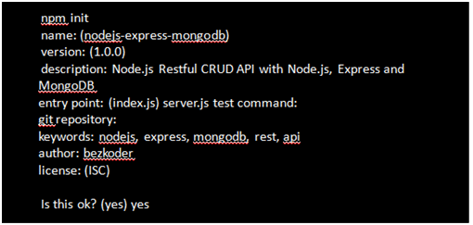
IMPLEMENTATION OF NODE JS AND EXPRESS
First, we create a folder
Next, we initialize the Node.js App with a package.json file:
We need to install necessary modules: express, mongoose, body-parser.

Slide 12
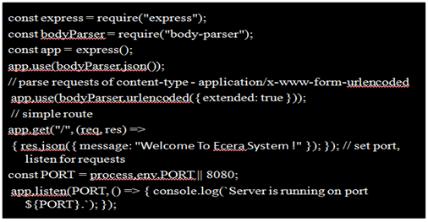
IMPLEMENTATION OF NODE JS AND EXPRESS
Run the command: npm install express mongoose body-parser –save
Setup Express web server
In the root folder, let’s create a new server.js file:
Now let’s run the app with command: node server.js.
Open your browser with url http://localhost:8080/, you will see:

Slide 13
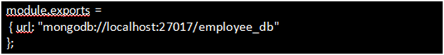
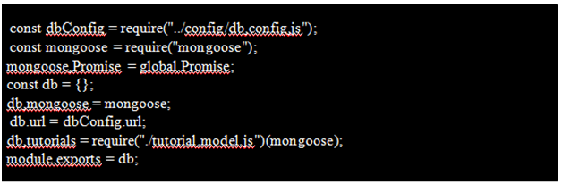
CONFIGURATION OF MONGO DB AND MONGOOSE
In the app folder, we create separate config folder for configuration with db.config.js file like this:
Define Mongoose
• We’re gonna define Mongoose model (tutorial.model.js) also in app/models folder in the next step.
• Now create app/models/index.js with the following code:

Slide 14
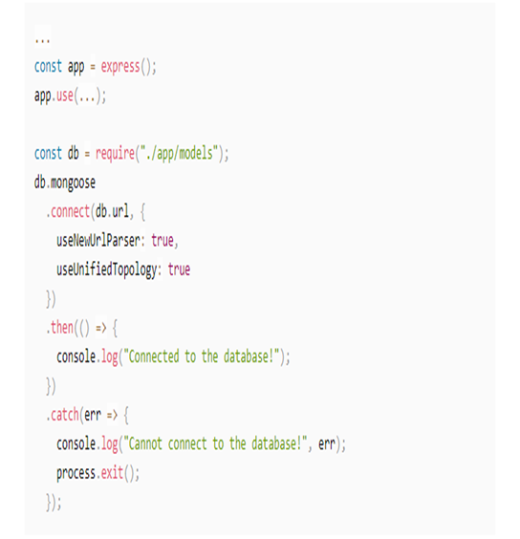
CONFIGURATION OF MONGO DB AND MONGOOSE
Don’t forget to call connect() method in server.js:

Slide 15
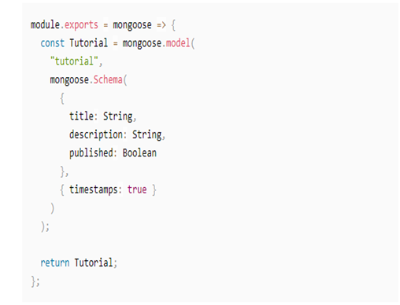
CONFIGURATION OF MONGO DB AND MONGOOSE
Define the Mongoose Model
In models folder, create tutorial.model.js file like this:

Slide 16
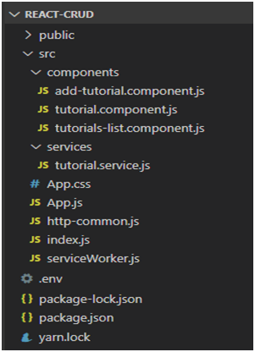
CONFIGURATION OF MONGO DB AND MONGOOSE
Run the Node.js Express Server
Run our Node.js application with command: node server.js.
React.js Front-end Technology
• React 16
• React-router-dom 5.1.2
• Bootstrap 4.4.1
• Project Structure
• package.json contains 4 main modules: react,react-router-dom & bootstrap.
– App is the container that has Router & navbar.
– There are 3 components: Tutorials List, Tutorial, Add Tutorial.
– Tutorial Data Service has methods for sending HTTP requests to the Apis.
– .env configures port for this React CRUD App.

Slide 17
SETUP OF REACT JS
Open cmd at the folder you want to save Project folder, run command:
npx crea te-react-app react-crud
When you first run create-react-app. you’ll end up with a folder like this -> fig
src/api.js - You’ll probably need to make calls to a backend API at some point. Put all that code here. If it gets too unwieldy in one file, make a src/api directory and put the area-specific API files under there – like userApi.js, product Api.js, etc.
src/components - All your Presentational (aka Dumb) components go here. These are the simple stateless ones that just take props.
src/containers - The Container components go here. These are the stateful ones, and the ones that make the API calls. If you’re using Redux, these are the ones that are connected to the store. Notice that CSS and tests are in the same folder as their respective components.

Slide 18
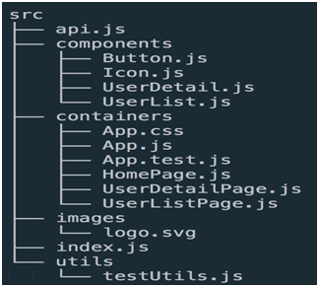
SETUP OF REACT JS
src/images - Put the images in one place to start with.
src/index.js - This is where you initialize the app and call ReactDOM.render, so it makes sense to keep this at the top level.
src/utils - You’ll probably end up with miscellaneous utility functions – error handlers,
formatters, and the like. I usually put them in a file inside utils so I can access them easily.
Index.js -> App.js -> calls components inside this file

Slide 19
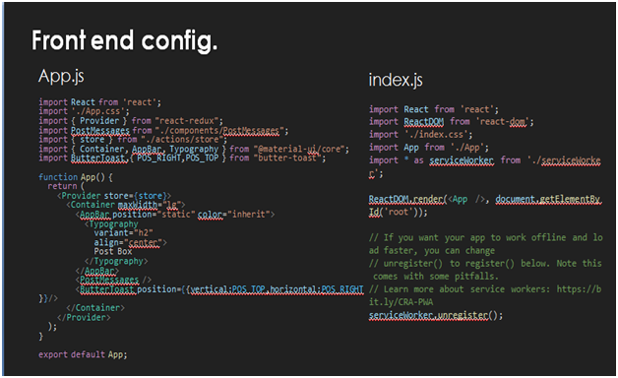
SETUP OF REACT JS

